Slide 1
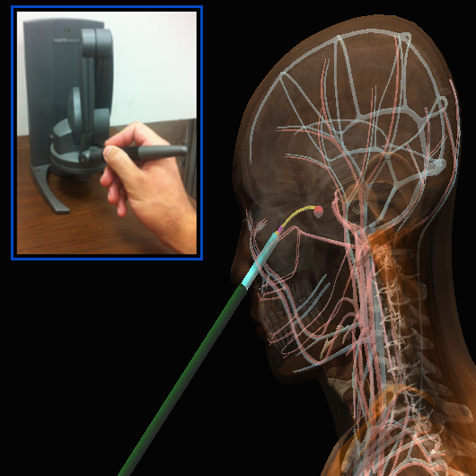
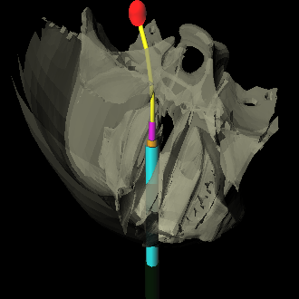
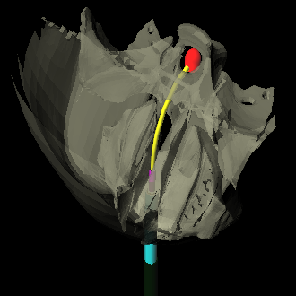
Interactive-rate Motion Planning for Concentric Tube Robots
Luis G. Torres, Cenk Baykal, and Ron Alterovitz
University of North Carolina at Chapel Hill

Slide 2
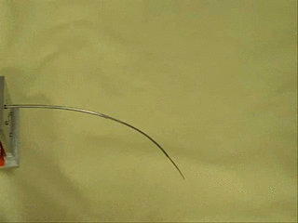
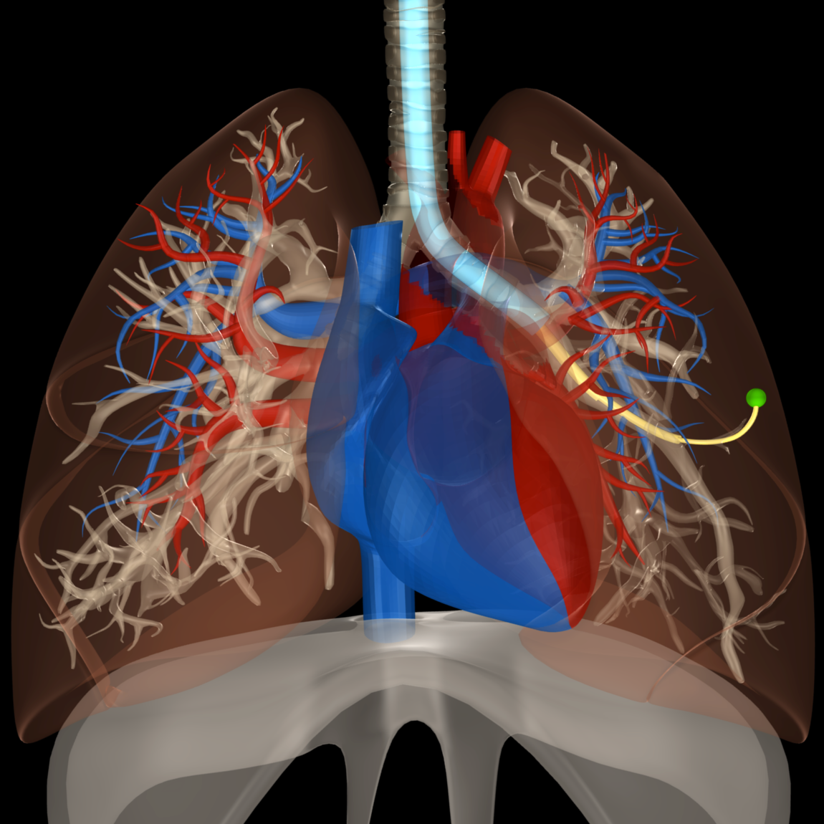
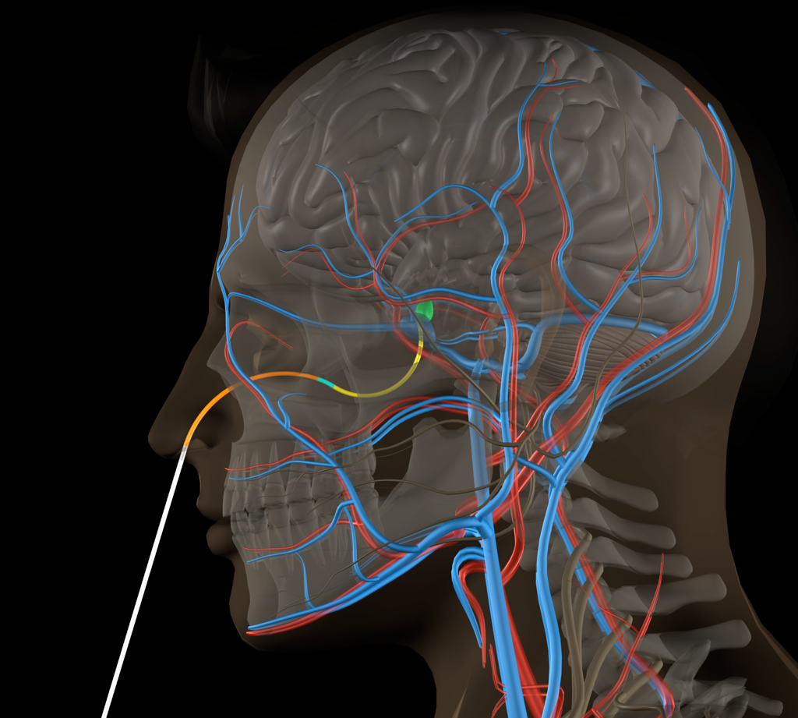
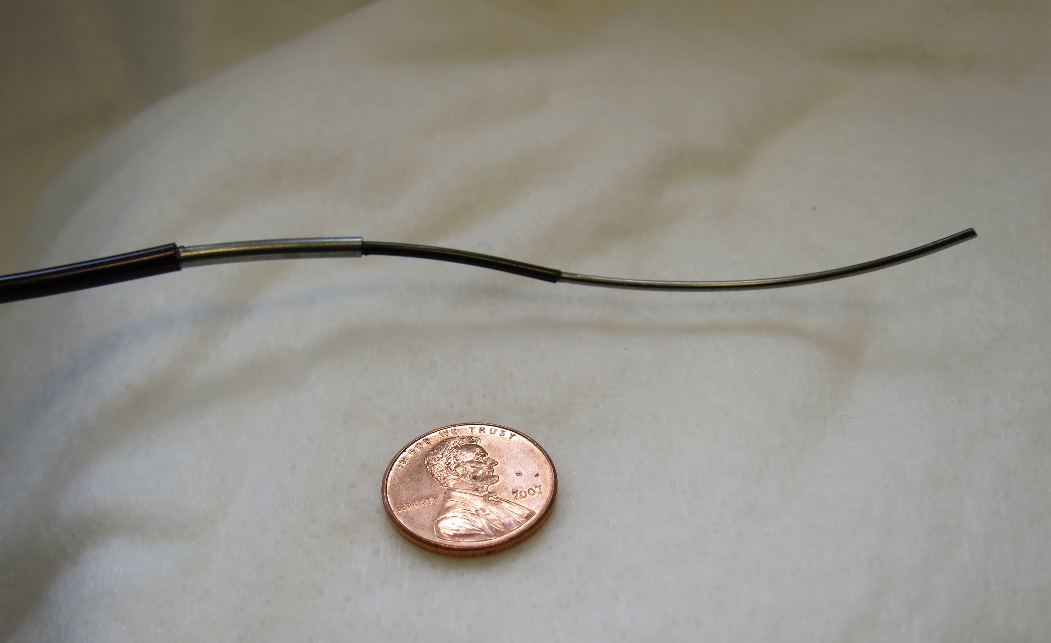
Concentric Tube Robots
Dr D. Caleb Rucker and Dr. Robert J. Webster III

Slide 3
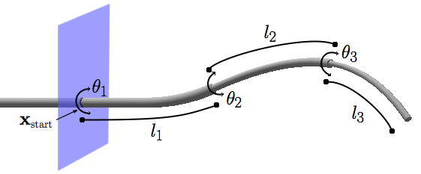
How do they work?
C-space: (n rotations x n translations)
Manual control is unintuitive

Slide 4

Teleoperative System
Accurate
Safe (collision-free)
Fast (interactive rates)
Let’s use motion planning!

Slide 5
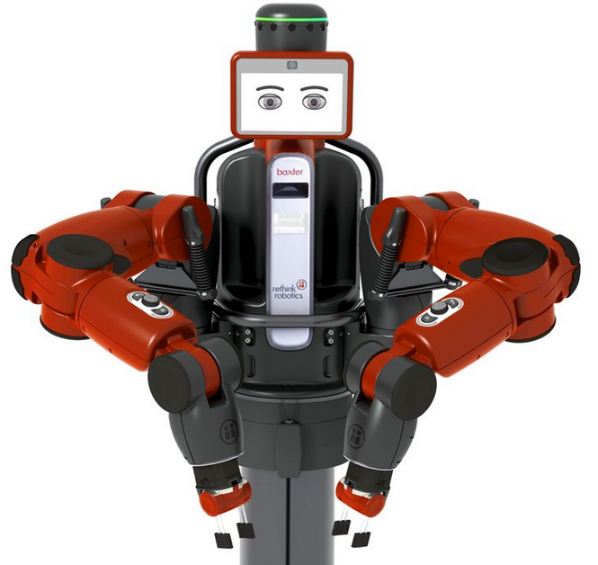
Challenges
Accuracy requires complex kinematic modeling:
Dupont et al.
Webster et al.
FK computation time:
Rethink Robotics
~0.001 seconds
~0.0000001 seconds

Slide 6
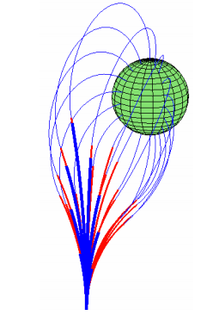
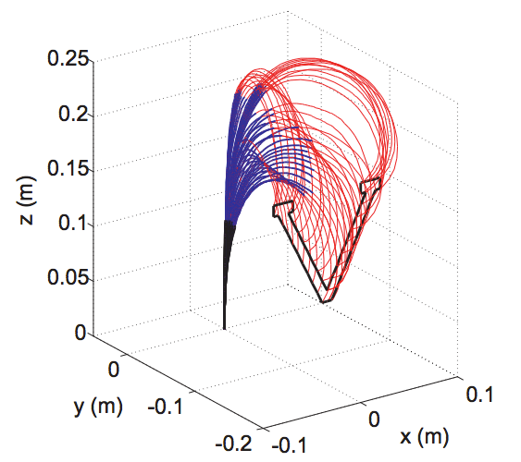
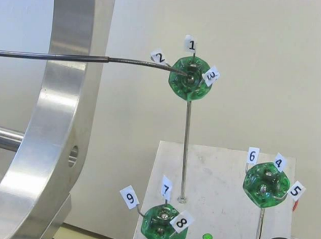
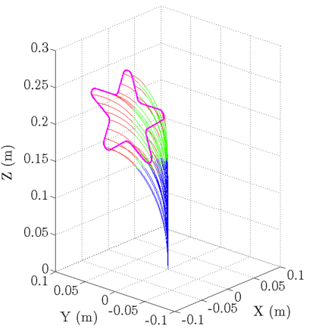
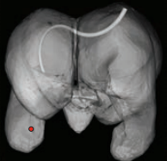
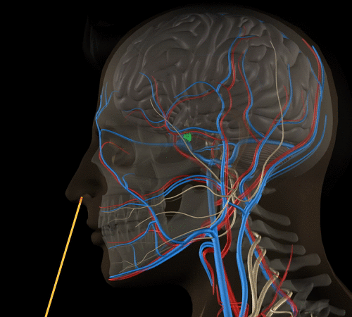
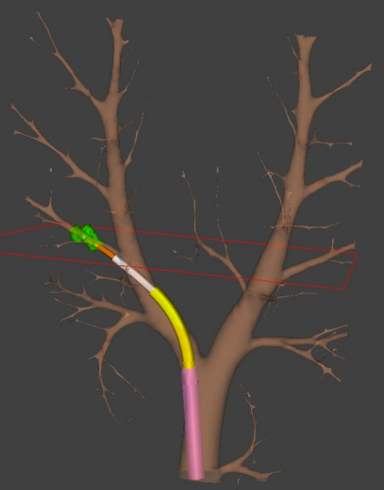
Prior Planning Work
Sears and Dupont, 2007
Rucker and Webster, 2011
Dupont et al., 2010
Xu et al., 2013
Bergeles and Dupont, 2013
Torres and Alterovitz, 2011
Trovato and Popovic, 2009

Slide 7
Our new planner
Accurate
Safe (collision-free)
Fast (interactive rates)

Slide 8


How do we do it?
Precomputation Phase
Interactive Planning Phase
Motivation: minimize online kinematics computations

Slide 9
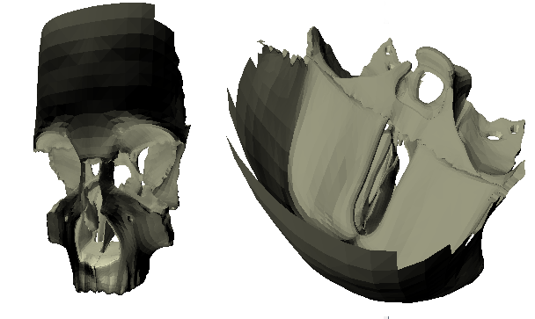
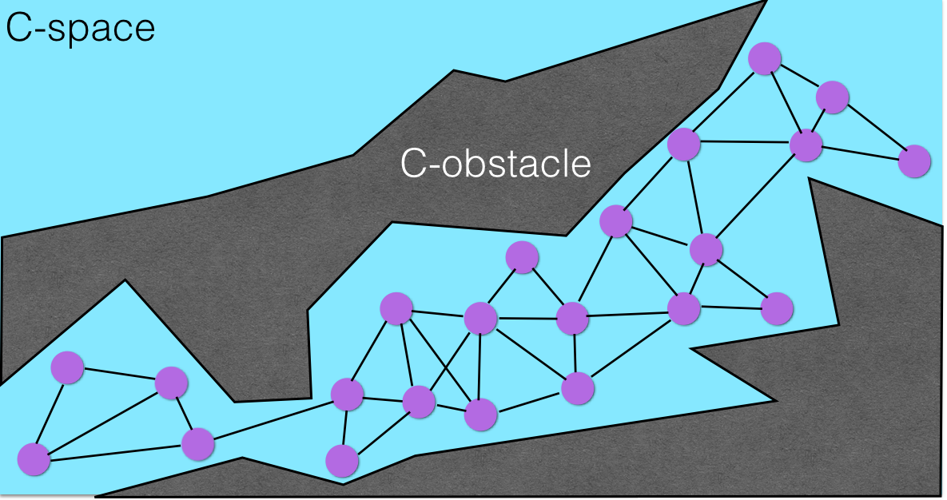
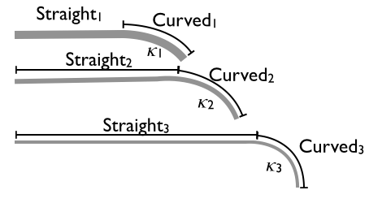
Precomputation Phase
Input
Output

Slide 10


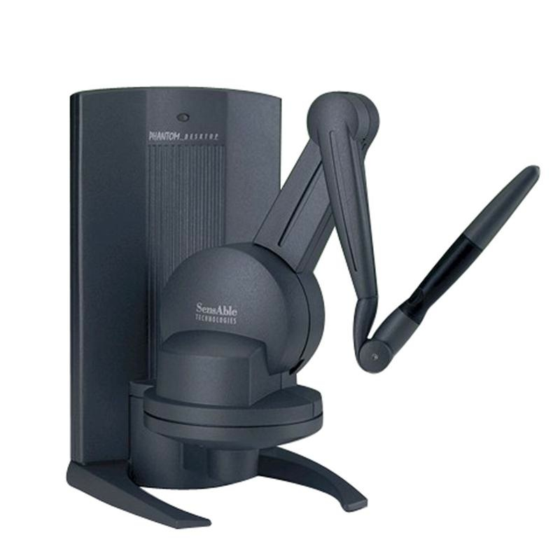
Collision-free Roadmap
Interactive Planning Phase
C-space
C-obstacle
Roadmap planning with A*
Read new robot goal from user input
Iterative Inverse Kinematics
Rapidly-exploring Random Graph (Karaman and Frazzoli, 2010)

Slide 11
Interactive Planning Phase
Get desired tip position from user
Collision-free roadmap
Send motion plan to robot
Roadmap planner
Iterative IK

Slide 12
Evaluation

Slide 13
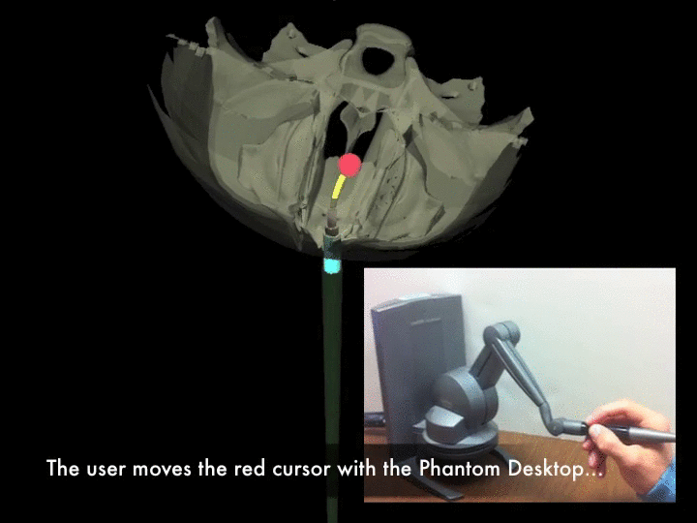
Evaluation

Slide 14
Quantitative Experiment
50,000 random (start, goal) pairs of robot configurations
3 versions of our motion planner:
IK only
Roadmap only
IK + Roadmap (Full)

Slide 15
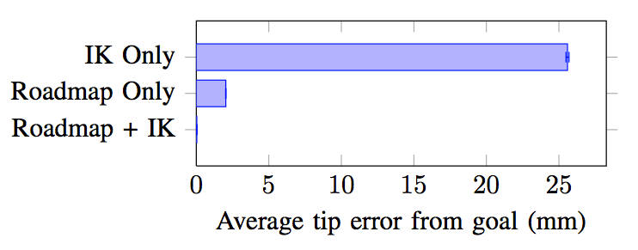
Results

Slide 16
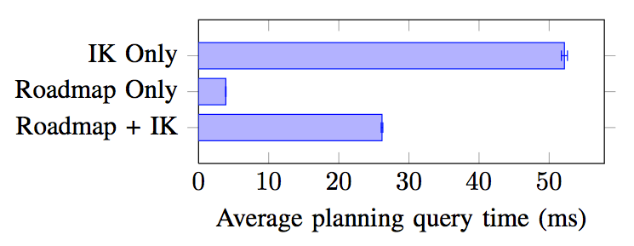
Results

Slide 17
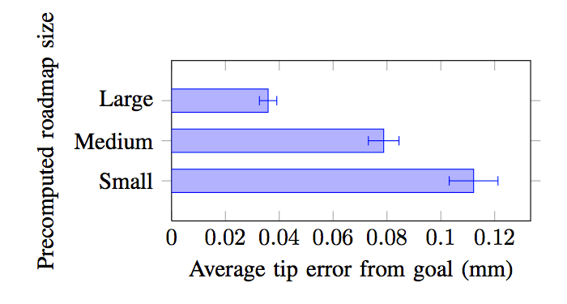
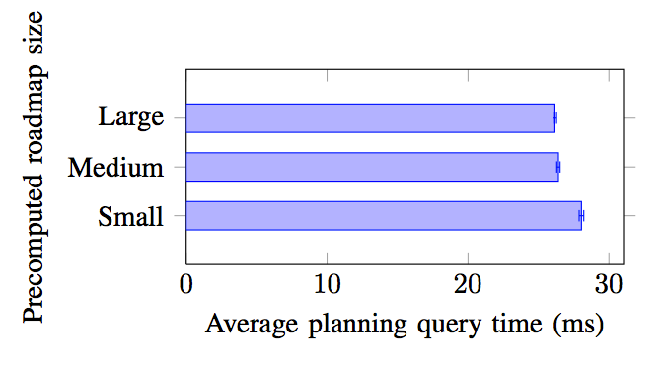
Roadmap computation time (hours)

Slide 18
Results
Roadmap Computation | # Vertices | Memory usage | Computation time
Small | 3,113 | 110 MB | 1 hour
Medium | 5,837 | 166 MB | 3 hours
Large | 11,019 | 350 MB | 6 hours

Slide 19
Results

Slide 20
Results

Slide 21


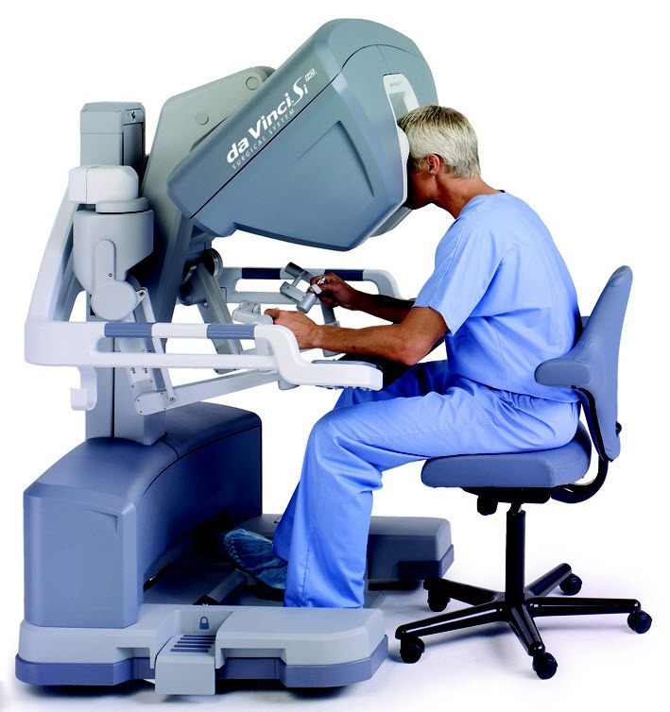
Future Work
Physical integration
Dynamic environments
Intuitive Surgical Inc.
Surgeon interface

Slide 22



Acknowledgements
GRFP DGE-1144081
R01EB017467
IIS-0905344
R21EB017952
IIS-1149965
MED Lab

Slide 23
Interactive-rate Motion Planning for Concentric Tube Robots
Contact: luis@cs.unc.edu

